Slide 1
Programming for
Data Science
Data Science at GT
http://bit.ly/2kjK7IT
(link to the materials)
http://bit.ly/2mfMixL (check-in)
Pin: 091619

Slide 2


Slide 3


Slide 5
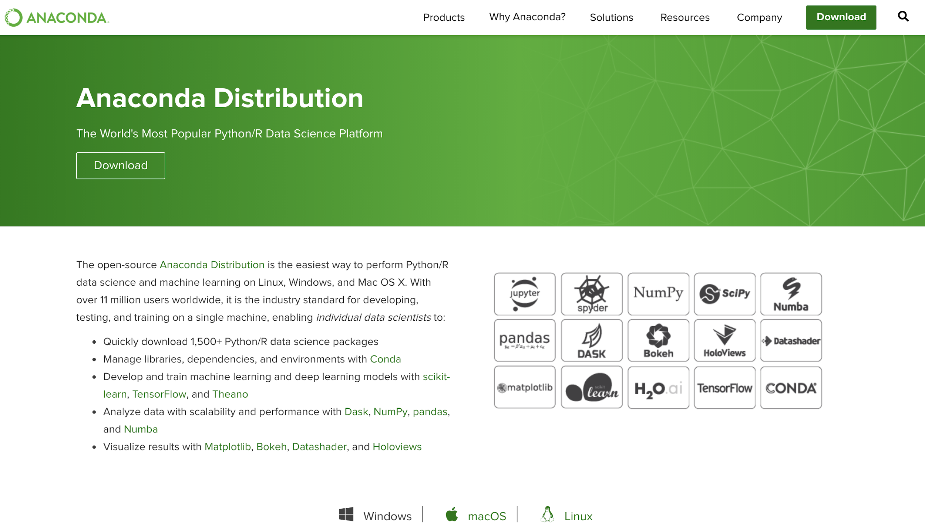
Anaconda Installation
Download and install from: https://www.anaconda.com/distribution/

Slide 6
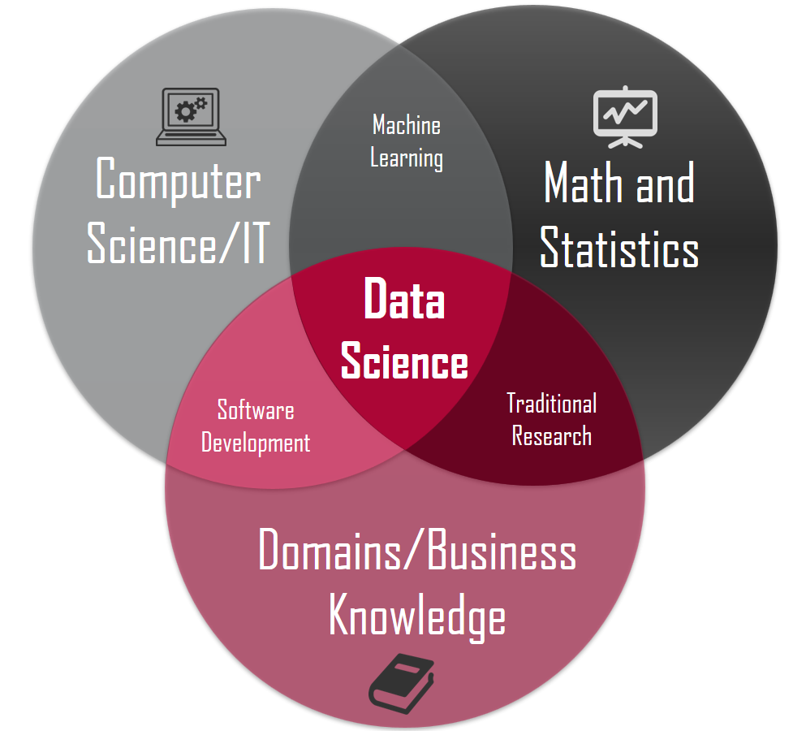
What is Data Science?
“Data science is the field of study that combines domain expertise, programming skills, and knowledge of math and statistics to extract meaningful insights from data.”
2.5 x 10¹⁸ bytes of data is created a day.
In the past 2 years, we produced more than 10 times the data created in the rest of human history.
As high as 80% of the data in an organization is unstructured, primarily in the form of text.

Slide 7
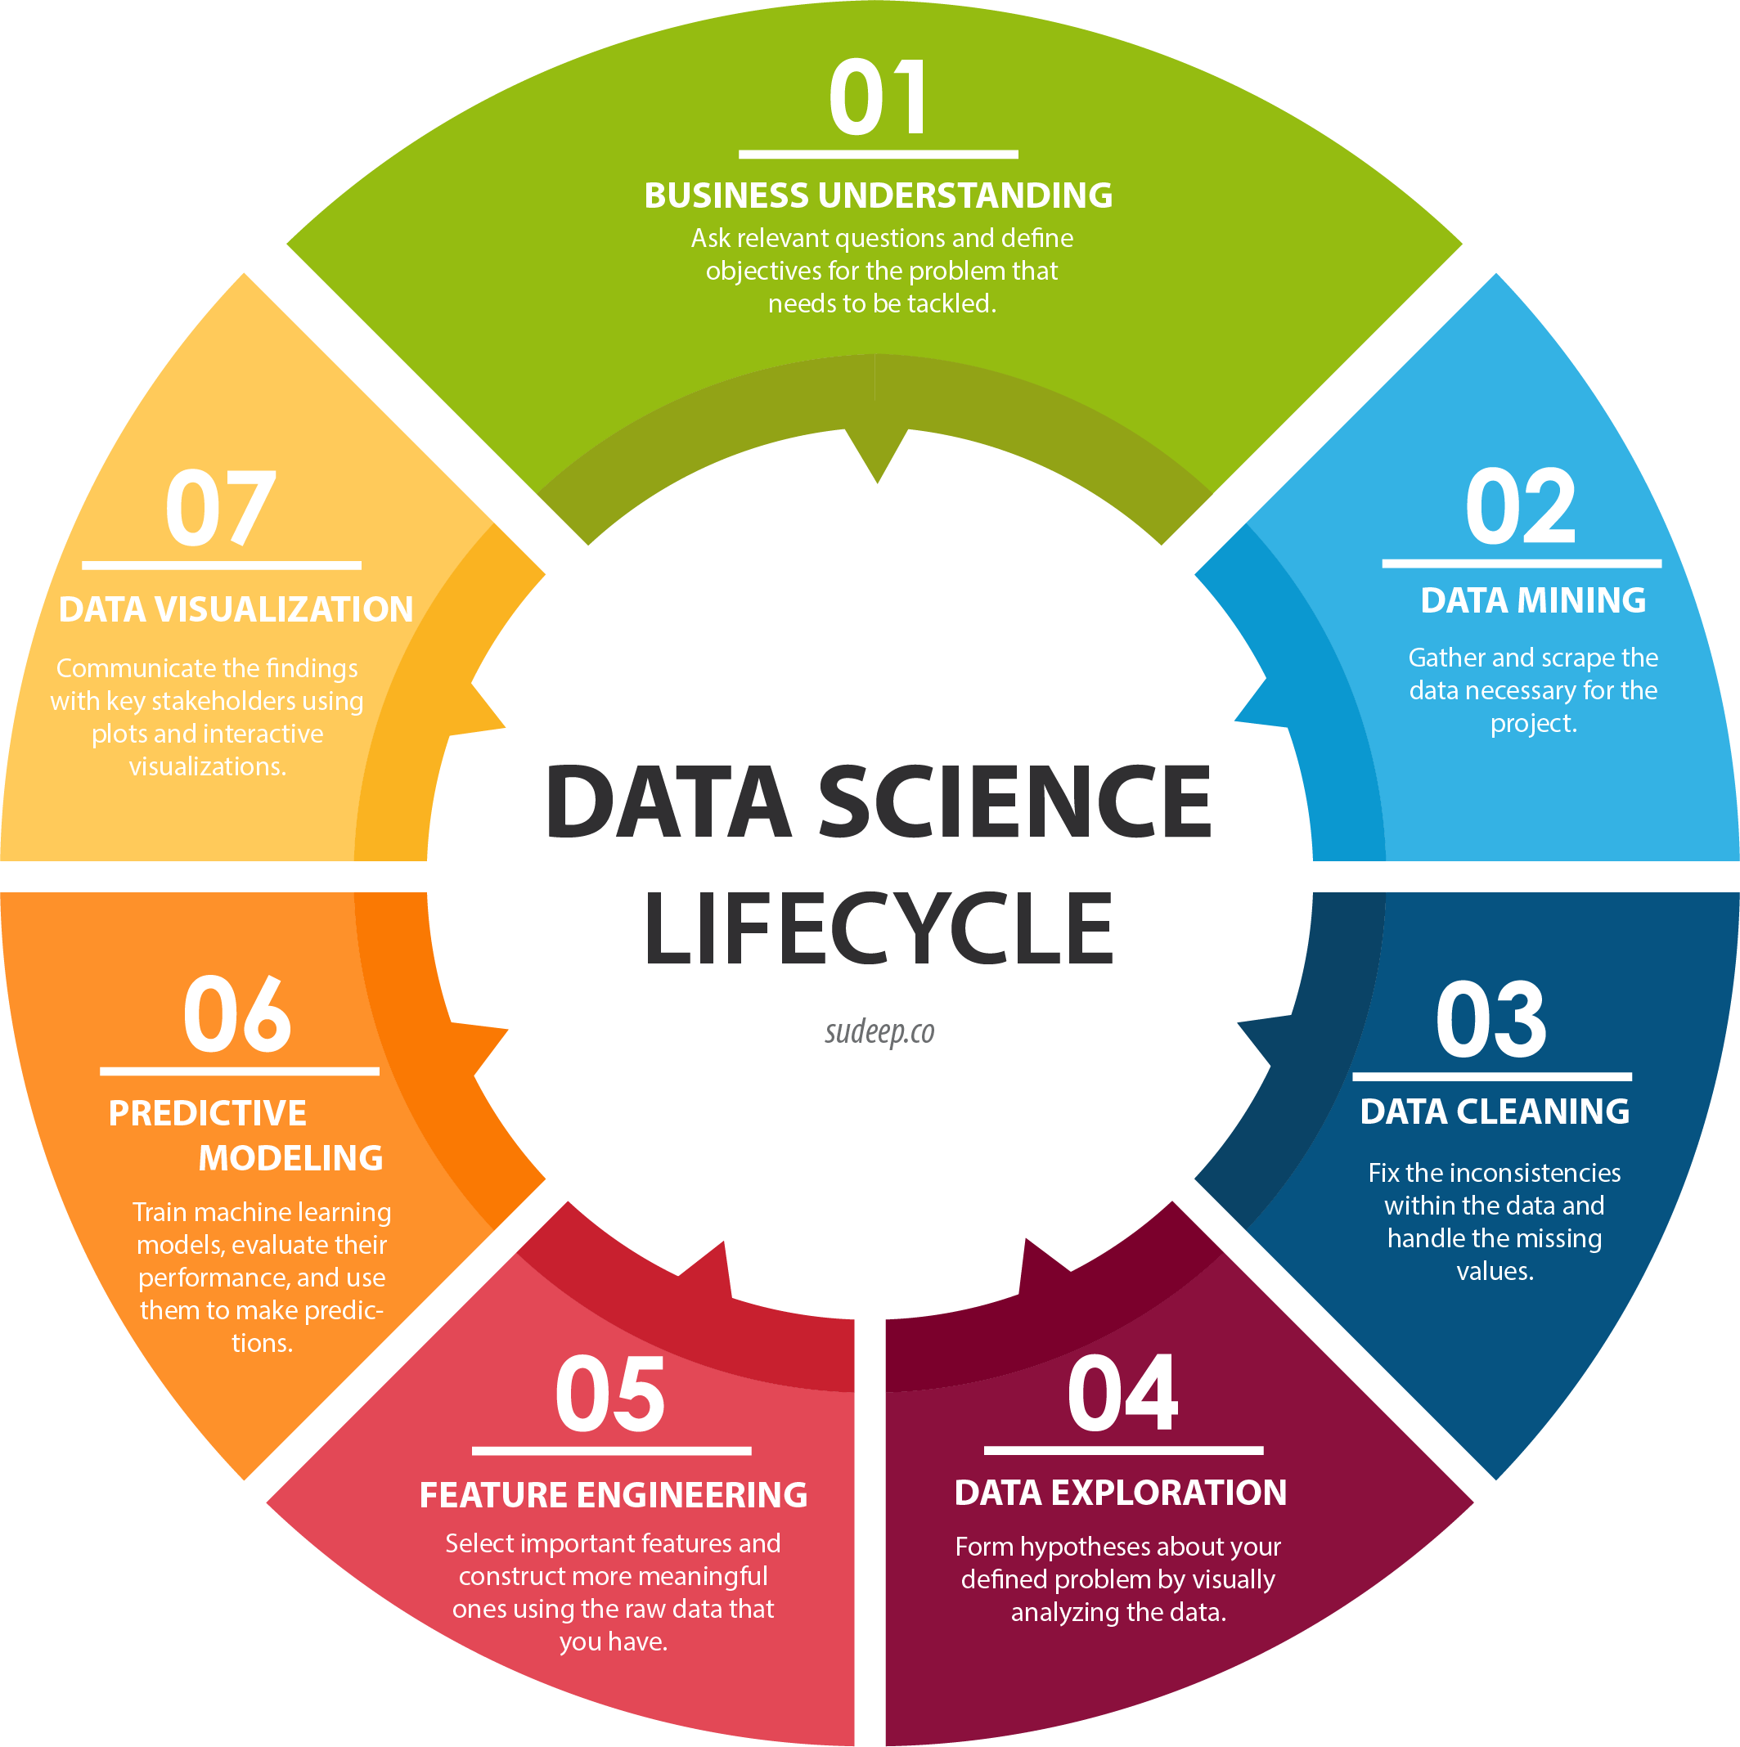
What can we do with data?
Regression (What will be the cost of a given land?)
Classification (Which set label does this belong to?)
Clustering (What group should this be in based on similarities?)
Anomaly Detection (In this weird? Is this an outlier?)
Recommendation (What policy should we take?)

Slide 8
Why Python?
Growing variety of libraries
Numpy, Scipy, Pandas, Matplotlib, Seaborn, Scikit-learn, Tensorflow
Easy-to-understand compared to R
Easy to pick up if you have coding experience
Integrates better than R with other platforms
Integrating your data analysis into an app or a website
Huge community that contributes updates

Slide 9
Python: Operators
Math
Addition a + b
Subtraction a - b
Multiplication a * b
Exponentiation a ** b
Modulus a % b
Regular Division a / b
Floor Division a // b (truncates decimals)
Assignment
Assignment x = 5
Math + Assignment x += 5 (e.g. add 5, then assign)
Comparison
equals x == 12
not equals x != 12
greater than x > 12
greater than or equal to x >= 12
smaller than x > 12
smaller than or equal to x >= 12
Membership
if item is in the sequence ‘a’ in ‘cat’
if item is NOT in the sequence ‘a’ not in ‘dog’
Identity
if id(x) is equal to id(y) x is y
if id(x) is NOT equal to id(y) x is not y

Slide 10
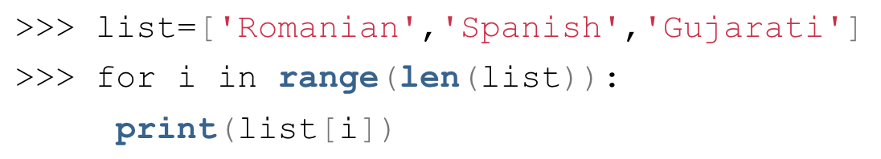
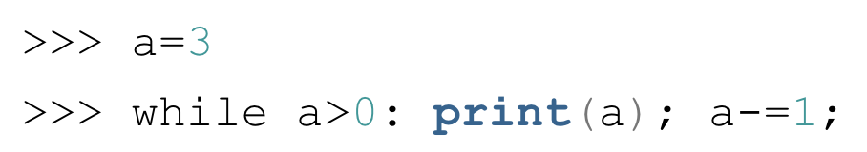
Python: Looping
For-loop
range() function
range([startInt], stopInt [, stepInt])
else statement for for-loop
Executes when condition is false
While-loop
else statement for while-loop
Similar to else statement for for-loop
Single-statement while-loop
Loop Control Statements
break statement
Stops the loop and shift control to the first statement outside the loop
continue statement
Skips the statements after continue and enter next iteration of the loop
pass statement
Null statement when need a particular loop, class, or function in our program, but don’t know what goes in it.
Nested Loops
Can declare in an inner loop a variable of same name as that of one in the outer loop
Remember to have proper indentation!

Slide 11
Python: Lists
Create a list weekdays = [‘tuesDay’, ‘wednesday’, ‘thursday’]
Access an element first_weekday = weekdays[0] last_weekday = weekdays[-1]
Modifying an element weekdays[0] = ‘tuesday’
Adding an element to the end of the list weekdays.append(‘friday’)
Inserting an element (e.g. insert at index = 0) weekdays.insert(0, ‘monday’)
Removing an element del weekdays[2] (remove by position) users.remove(‘thursday’) (remove by element content)
Python has 4 kinds of data collection:
List
Ordered and mutable
Duplicate members allowed
Tuple
Ordered and immutable.
Duplicate members allowed
Set
Unordered and unindexed
No duplicate members
Dictionary
Unordered, but immutable and indexed
No duplicate members

Slide 12
Python: Other methods for Lists
sort(): sorts the order permanently (Remember list is immutable!) weekdays.sort()
sorted(list): takes a list and return a copy of the sorted version of it newList = sorted(list)
reverse(): reverse the order of a list weekdays.reverse()
min(), max(), ages(): simple statistics for numerical data
pop(index): remove the element at the index in the list and return it newList = weekdays.pop()
List Comprehension upperCase_weekdays = [day.upper() for day in weekdays] Q: What do you think this line of code does?

Slide 13
Python: Dictionaries
Create a dictionary favNum = {‘Henry’: 5, ‘Jason’: 12}
Access an element with the key print(favNum[‘Henry’])
get() method henry_fav = favNum.get(‘Henry’) Q: What does the following code do? michael_fav = favNum.get(‘Michael’, 0)
Adding a new key to the dictionary favNum[‘Sarah’] = 7 Q: How do we add a key to a specific position?
Modify a key favNum[‘Henry’] = 30
Removing a key del favNum[‘Jason’]
Get the length of the dictionary numPeople = len(favNum)
Q: How do we loop through a dictionary by key-values pair? Or just by keys/values? Extra 1: Can you make a list of dictionaries?
Extra 2: Can you make a dictionary of lists?
Extra 3: Can you make a dictionary of dictionaries?

Slide 14
Python: Slicing
Get the first two days in weekdays weekdays = [‘monday’, ‘tuesday’, ‘wednesday’, ‘thursday’, ‘friday’] first_two = weekdays[:2] (days from the start to index = 2 - 1 = 1)
Get the middle three days in weekdays middle_three = weekdays[1:4] (days from index = 1 through index = 4 - 1 = 3)
Get the last three days in weekdays last_three = weekdays[-3:] (days from index = -3 to the end)
Q: How can we copy a list with slicing? Q: How do we slice a dictionary?

Slide 15
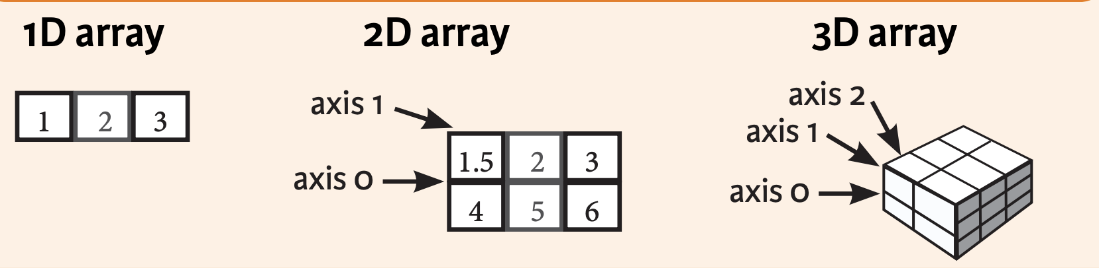
Numpy - Numerical Python
Fundamental Object: ndarray
Vectorized operations on arrays
Broadcasting
File IO and memory-mapped files
1D Array 1d_array = np.array([1,2,3])
2D Array 2d_array = np.array([[1,2,3], [4,5,6]])
3D Array 3d_array = np.array([[[1,2,3], [4,5,6]], [[11,12,13], [14,15,16]]])

Slide 16
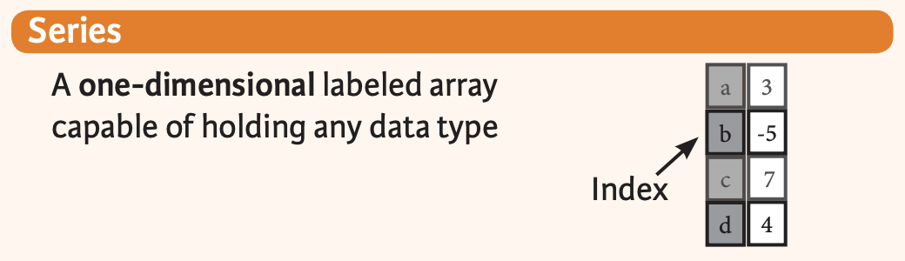
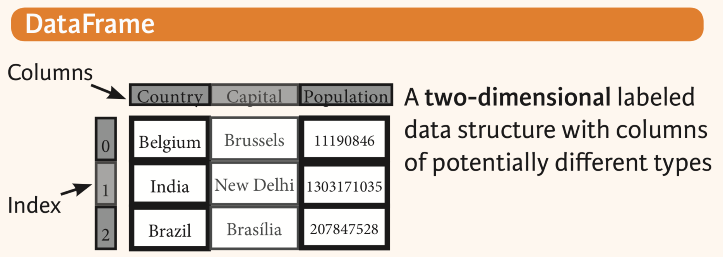
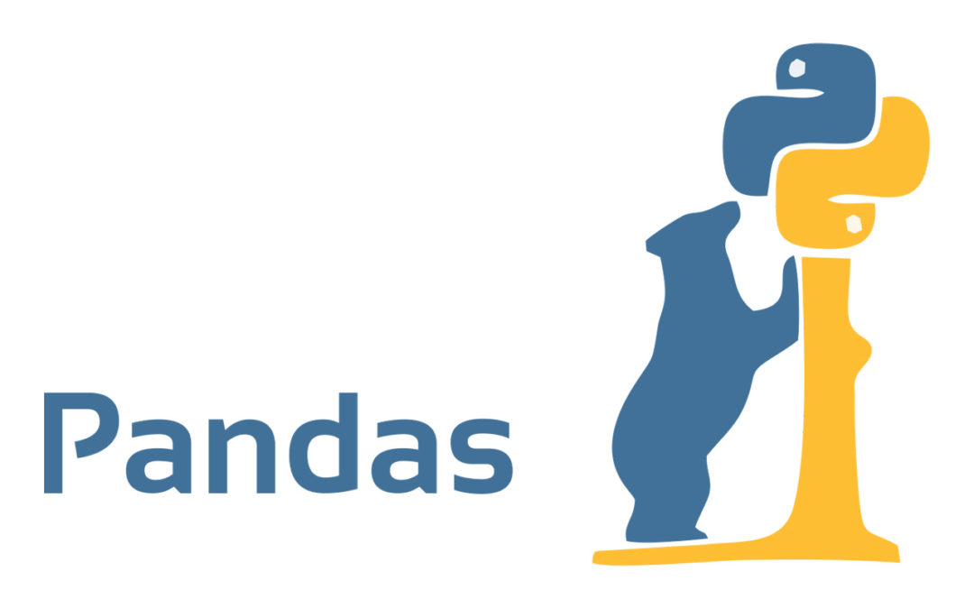
Pandas
Series: 1D labeled array capable of holding any data type with axis labels or index
Data Frame: two-dimensional labeled data structures with columns of potentially different types, including DataFrame and the following:
Series
Numpy ndarray
Dictionaries of ndarrays, lists, dictionaries or Series

Slide 17

Matplotlib
2D plotting library which produces publication quality figures
Line plots, scatter plots, histograms, pie charts, etc.
Useable in Python scripts, the Python and IPython shells, the Jupyter Notebook, etc.
Not built upon Numpy/Scipy

Slide 18
Question?

